Slide 1

Atm simulator
CREATED BY :
ABHIJEET KARMAKER (C0720286)
NARESH GUNIMANIKULA(C0719672)
PRIYANKA MODI (C0717925)

Slide 2

DESCRIPTION
Automated teller machine, a machine at a bank branch or other location which enables a customer to perform basic banking activities even when bank is closed.
Designed and Implemented an ATM Simulator that simulates the functions of a real ATM and more.
The ATM will support PIN authentication, Balance Inquiry, Deposit, Withdrawal, Fast Cash, Mini Statement, Pin Change, Email Alerts and Registration for opening bank account.

Slide 3
ARCHITECHTURE OF ATM SIMULATOR
ATM SYSTEM
LOGIN
REGISTRATION
TRANSACTIONS
DEPOSIT
WITHDRAWAL
FAST CASH
MINI STATEMENT
PIN CHANGE
BALANCE INQUIRY

Slide 4
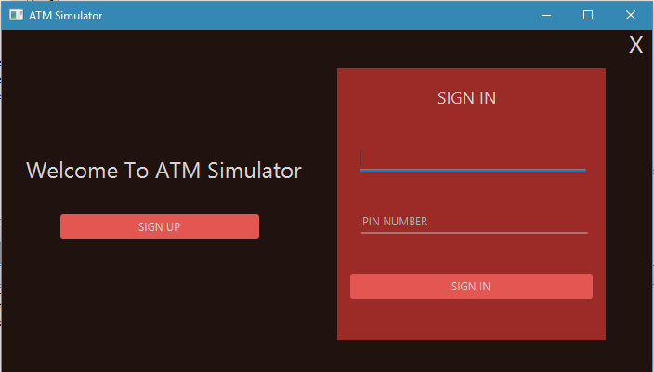
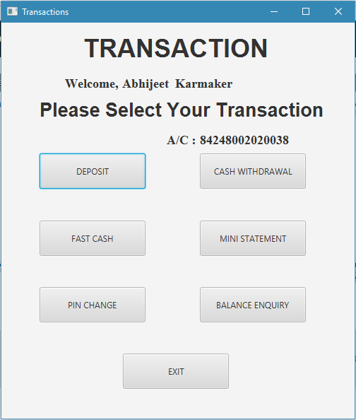
Designs

Slide 5
Contributions to project
System Design and Database Implementation: By Priyanka Modi and Abhijeet Karmaker
Implementation and Execution: By Abhijeet Karmaker and Naresh Gunimanikula
Testing and Deployment:
By Naresh Gunimanikula and Priyanka Modi

Slide 6
WHY THIS?
FASTER CASH DEPOSIT AND WITHDRAWAL.
INSTANT BALANCE INQUIRY.
MONTHLY STATEMENT TO BE SENT TO YOUR REGISTERED EMAIL.
CHANGING OF PIN.
MAXIMUM TRANSACTION OF $500 PER DAY
OPENING NEW BANK ACCOUNT INSTANTLY

Slide 7
TECHNIQUES USED IN THIS PROJECT
LANGUAGE
JAVA (FXML)
DATABASE
MYSQL (MAMP SERVER using PHPMYADMIN)
PLATFORM
NETBEANS 8.2, Java(TM) SE Runtime Environment 1.8.0_144, Scene Builder 2.0
CONNECTIVITY
JDBC-MYSQL

Slide 8
HOW IT IS IMPLEMENTED
The implementation of ATM Simulator includes designing the user interface using Java FXML
This uses different panels for placing various controls on it.
The application maintains the connection with the database using JDBC.
Various actions implements ATM Database System applications are:
Creating new banking account instantly which will insert all data into the database.
Fetching account details from database to authenticate login page and give access for transactions.
Transaction details will be inserted into the database table which is linked with the user account table.
Email will be sent to the respective account holder for each transactions.

Slide 9
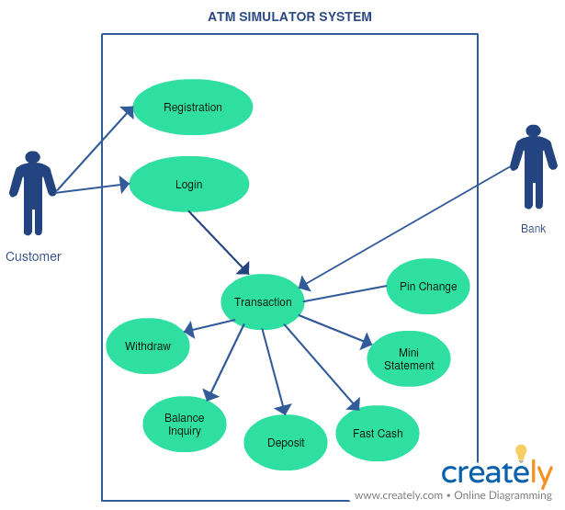
USE Case diagram

Slide 10
Problems we Handled
Combo Box Data and Radio Button Data insertion into database.
Adding multiple Checkbox list Data into a single column.
Sending emails to the account holder with mail and activation jar file.
Creating PDF file with iTextpdf jar file.
Transferring of values from one page to another without saving the data in database and inserting all data together into the database from the last page.

Slide 11
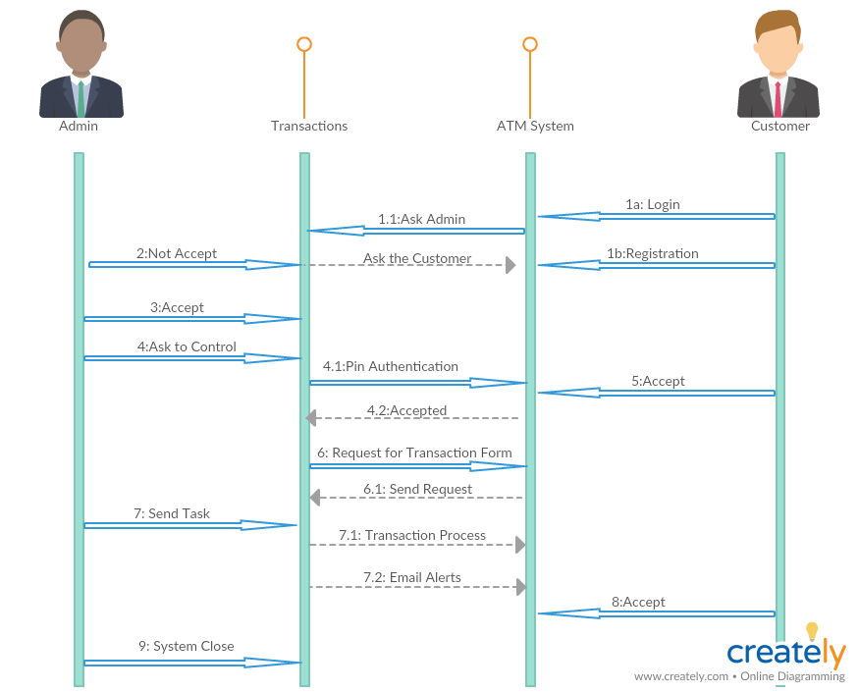
Use sequence diagram

Slide 12
Testing
Junit Testing
Junit testing of the Database Class.
Junit testing of the User Account and User Transaction Class.
End User Testing
Manually tested by end users.

Slide 13
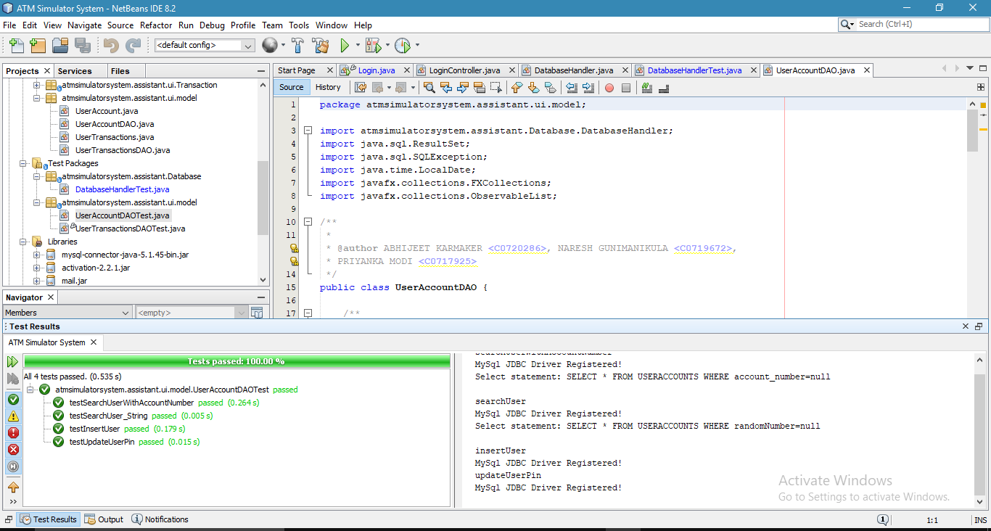
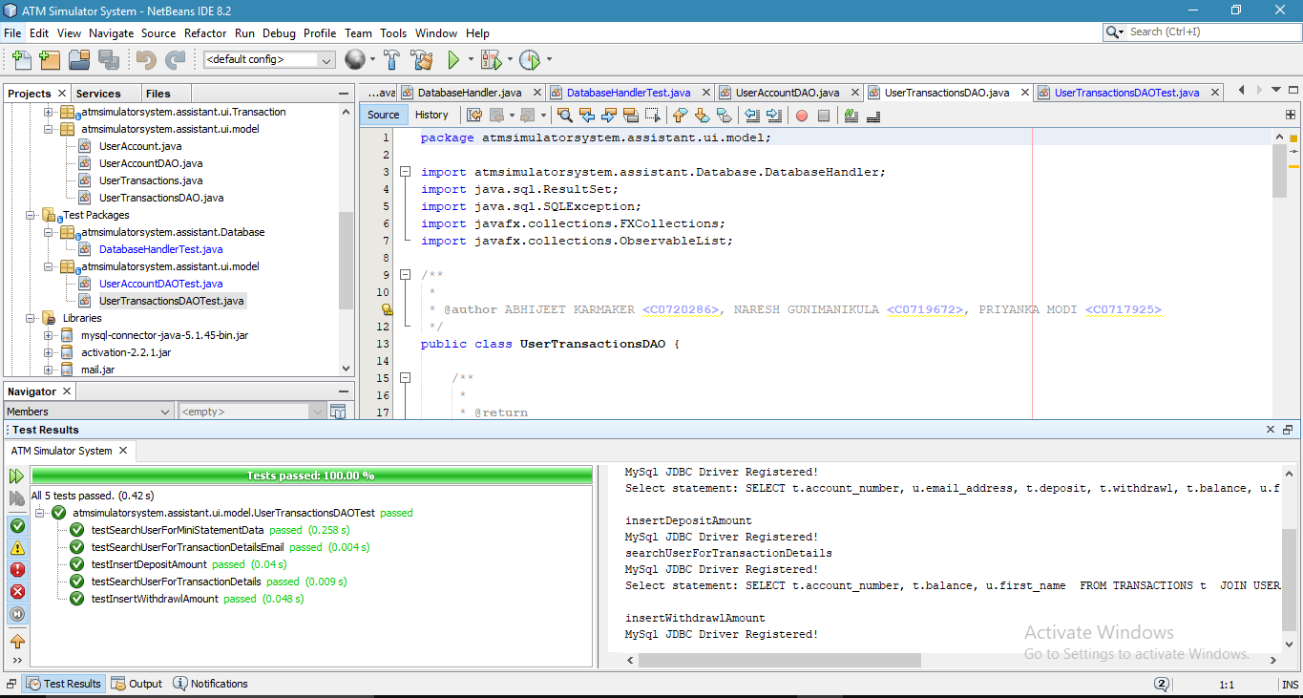
Test Modules

Slide 14
Future enhancement
Implementation of Digital Banking in future.
Finger Print Reader and Eye Detection System for Security Purpose.

Slide 15

Thank you page

